Slide 1
Natural Language Processing in Python
Fiona Shen-Bayh
University of California, Berkeley
April 2018

Slide 2
Overview
Natural language processing
Text as Data
Cleaning text
Converting text to numbers
Interpretation
Common methods and applications

Slide 3
Text as Data
We know how to read and analyze a single document.
But what about hundreds or even thousands of documents?
Is it possible to automate this task?

Slide 4
Natural Language Processing
NLP is a process of using computer algorithms to understand and analyze natural language.
Everyday examples:
Autocorrect on your phone
Google translate
Spam filters in your email app

Slide 5
NLP and Social Research
As more text becomes available through the web and other digital databases, researchers are increasingly using NLP methods to analyze large bodies of text for social science and humanities applications.

Slide 6
NLP and Social Science
Grimmer (2010): devised topic model to measure political priorities of U.S. senators based on content in their press releases
Stewart and Zhukov (2009): developed a codebook of discourse for Russian political and military elites to measure whether actors have a restrained, activist, or neutral positions on the use of force
King, Pan, Roberts (2013): web scraped thousands of Chinese social media posts and analyzed content using NLP to identify patterns of state censorship

Slide 7
NLP Software
Many off-the-shelf programs have not been tested on a wide range of content types.
Writing your own NLP program gives you enhanced flexibility and control over your text analysis.

Slide 8
What NLP can do
Automatically extract important features from large bodies of text.
Provide efficient means of synthesizing and comparing different texts.
Classify texts into important groupings.

Slide 9
What NLP cannot do
A computer is not a human.
As of now, humans are still better interpreters of natural language than computers.
(But we are slower readers!)

Slide 10
Acquiring Text
Archives, libraries
Documents will need to be scanned and converted to TXT using OCR
Online databases
LexisNexis, ProQuest
Anywhere from the web
Download with web scraper or web driver

Slide 11
Terminology
Natural languages are used for everyday communication (English, Norwegian).
Artificial languages are used by programmers (Python, C++, JavaScript).

Slide 12
More Terminology
Unit of analysis: text or document
Body of texts: corpus
Bag-of-words: texts can be described by word frequencies, assumes that syntax does not matter.

Slide 13
Pre-Processing Text
Not all words are considered equally important to our analysis.
Pre-processing involves steps to “clean” the text of irrelevant data.

Slide 14
Pre-Processing Text
Pre-processing involves several steps to “clean” the text of irrelevant data.
punctuation: remove ?,.!-”()[]{}

Slide 15
Pre-Processing Text
Pre-processing involves several steps to “clean” the text of irrelevant data.
stemming: remove ends of words
Family, families, families’ → famil

Slide 16
Pre-Processing Text
Pre-processing involves several steps to “clean” the text of irrelevant data.
“stop” words: drop function words
it, the, a, is, are…

Slide 17
Creating a Vocabulary
After pre-processing, we are left with a vocabulary of unique words that will become the primary features of our text.

Slide 18
Transforming the Vocabulary
This vocabulary is transformed into vectors. Each document is represented as a count vector.

Slide 19
Count Vectors
Doc₁ = [ 0, 0, 1, 0, 0, 3…]
Doc₂ = [ 1, 0, 0, 0, 0, 2…]
Doc₃ = [ 0, 0, 0, 0, 0, 1…]
Doc₄ = [ 0, 0, 0, 0, 0, 0…]
Doc₅ = [ 1, 1, 0, 0, 0, 2…]
Doc₆ = [ 0, 0, 0, 0, 0, 1…]
Doc₇ = [ 1, 0, 0, 2, 0, 2…]
Doc₈ = [ 2, 0, 0, 0, 0, 0…]
Numbers represent the frequency of unique words in a document

Slide 20
Document-Term Matrix
A collection of count vectors is called the document-term matrix, or dtm.
Each row of the matrix is a different document.
Each column is a term.
Contains mostly zeroes (sparse).

Slide 21
Document-Term Matrix
1 0 0 0 0 1 0 2
0 0 0 0 1 0 0 0
0 0 0 0 0 0 0 0
0 0 1 0 0 0 1 0
1 0 0 0 0 0 0 2
0 0 0 0 0 0 0 0
0 2 1 0 0 3 0 0

Slide 22
A real world example
The following slides show what this process actually looks like from start to finish.

Slide 23
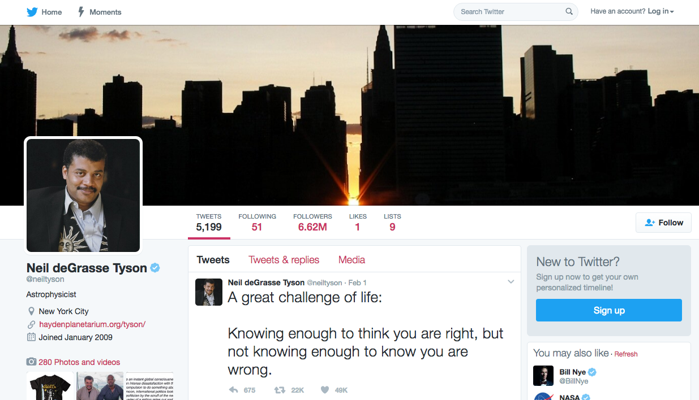
Neil deGrasse Tyson’s Twitter

Slide 24
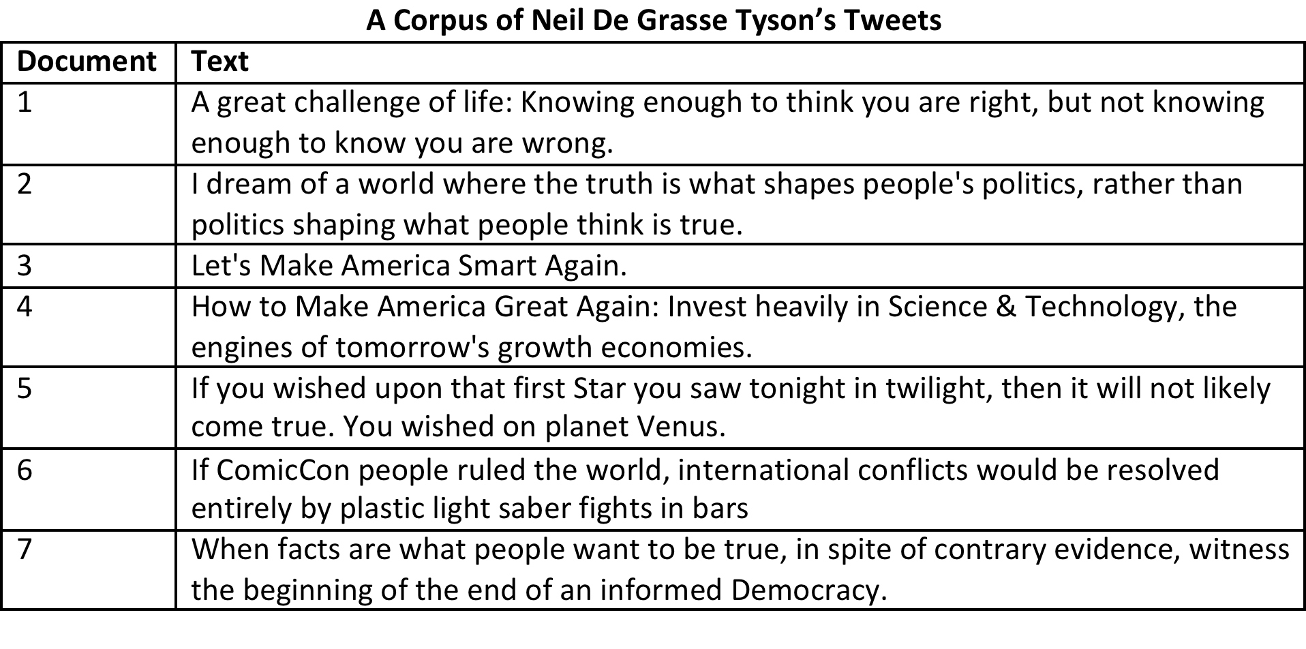
The Corpus of Tweets

Slide 25
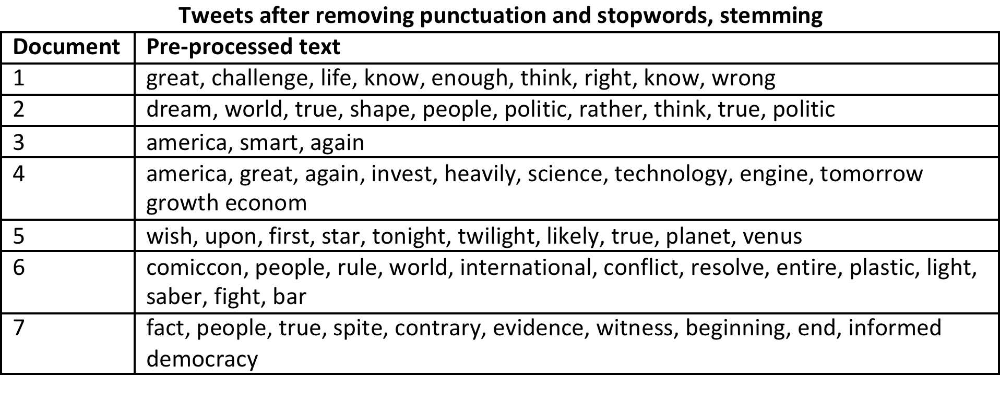
The Pre-Processed Corpus

Slide 26
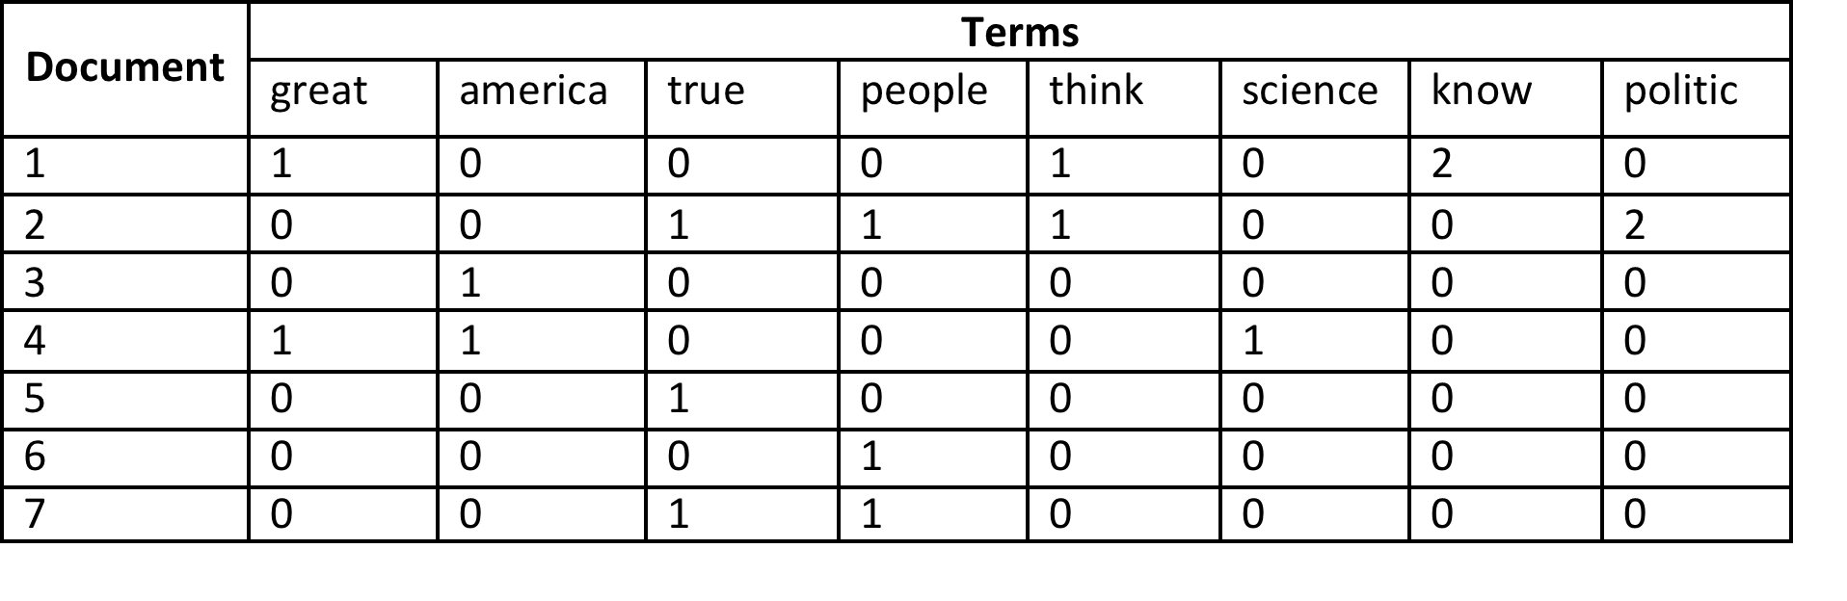
The Document-Term Matrix

Slide 27
Why do we do this?
Creating a document-term matrix simplifies analysis by narrowing our focus to the core content of each document.

Slide 28
Why do we do this?
Core content varies from project to project.
Sometimes we care about common terms, but other times we care about rare terms.
These decisions affect the pre-processing stage, which words to keep or discard.

Slide 29
Why do we do this?
Regardless of the task, the process of converting words to numbers, documents to vectors, and corpora to matrices makes qualitative text machine readable.

Slide 30
Why do we do this?
After processing text, computers can read and synthesize content we are interested in to find broad patterns across thousands of documents.

Slide 31
Why do we do this?
Computers are basically doing what humans do – read texts – but on a larger scale and in a more systematic way.

Slide 32
Methods
Many NLP applications rely on machine learning algorithms, which take raw data as input and automatically detect patterns for output.
Machine learning methods may be supervised or unsupervised.

Slide 33
Supervised vs. Unsupervised
Supervised and unsupervised methods are often cast as competitors. But they have different objectives.
Supervised methods: you have predetermined categories and documents that need to be placed in those categories.
Unsupervised methods: you don’t have a predetermined categorization scheme.

Slide 34
Unsupervised Methods
With unsupervised methods, we use modeling assumptions and underlying properties of texts to estimate a set of categories and simultaneously assign documents to those categories.

Slide 35
Unsupervised Methods
Unsupervised methods can identify categories of text that are theoretically useful, but perhaps understudied or previously unknown.
Also known as topic modeling.

Slide 36
Topic Models
Statistically speaking, a topic model is a probability mass function over words.
Substantively speaking, topics are distinct concepts.

Slide 37
How does Topic Modeling work?
Say we have a corpus of documents.
We only see the raw text.
But we do not know a priori the topics contained within these documents.
Topics are hidden variables that make up the underlying thematic structure of the corpora.

Slide 38
How does Topic Modeling work?
We can infer topics by computing their posterior distribution, conditioning on the documents themselves.
By using probability models, we can assign topic probabilities to unique words in each document.

Slide 39
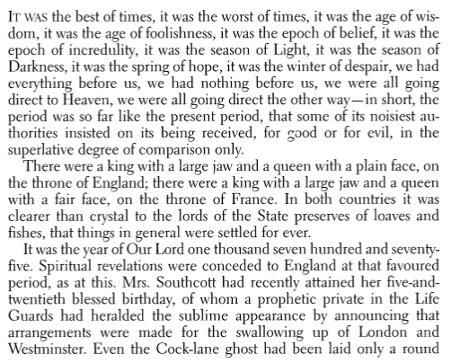
From Start…
The raw document

Slide 40
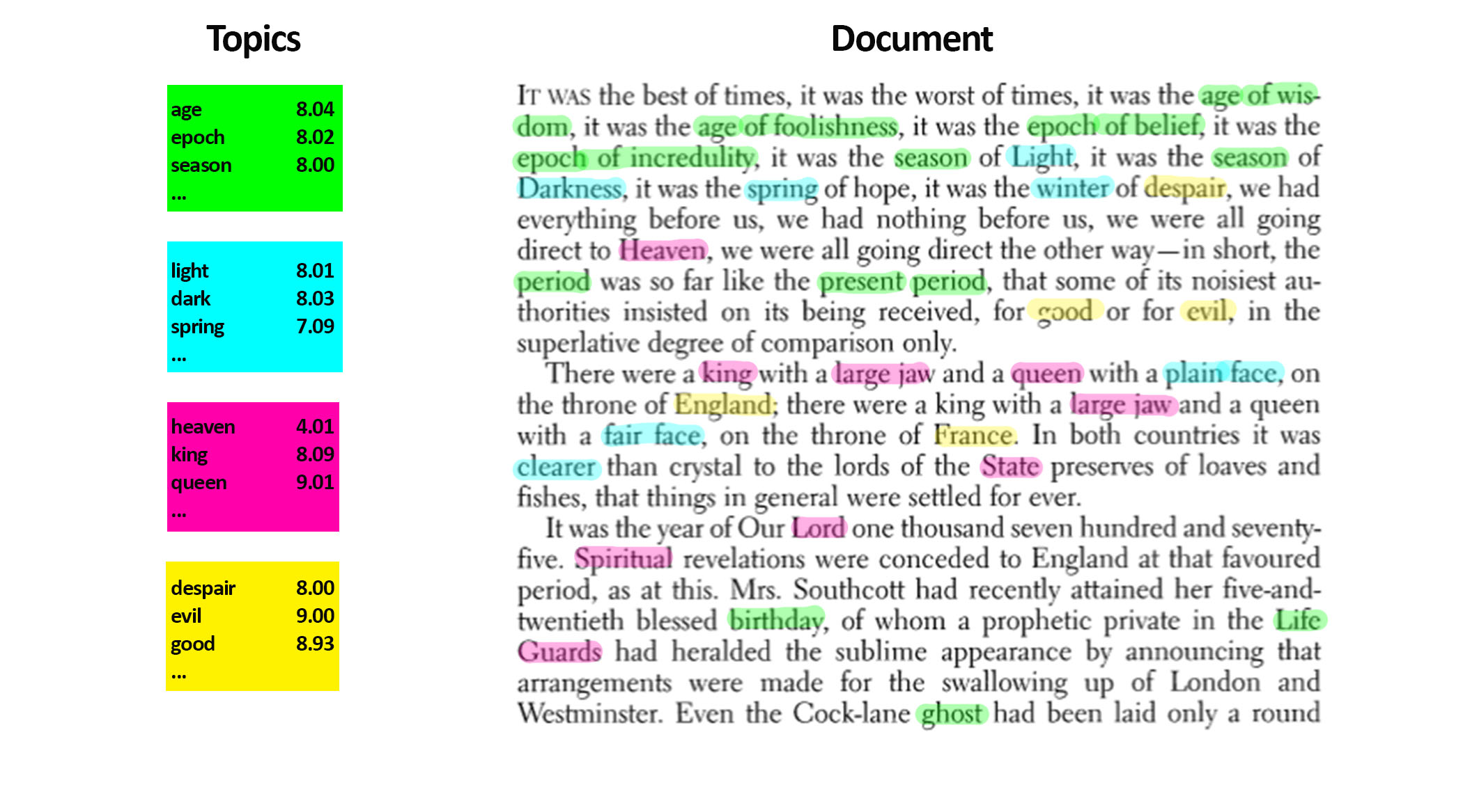
…to Finish

Slide 41
Topic Models: a hierarchy
Topic models have a hierarchical structure:
The top level contains information about key features contained in the documents. This info is used to estimate the different topics.

Slide 42
Topic Models: a hierarchy
Topic models have a hierarchical structure:
The middle level measures the extent to which each document is focused on the estimated topics.

Slide 43
Topic Models: a hierarchy
Topic models have a hierarchical structure:
The bottom level assigns each document to a single topic.

Slide 44
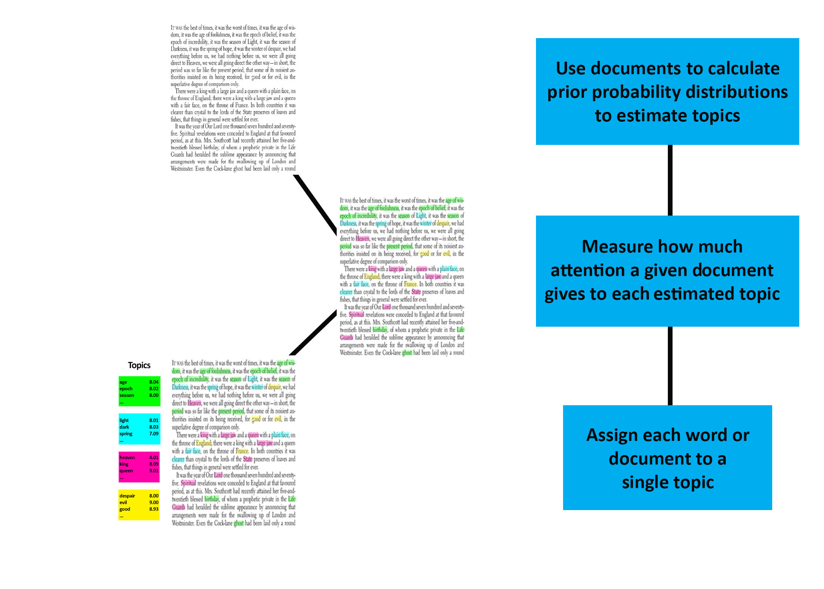
Topic Models: a hierarchy

Slide 45
Topic Models
Different types of probability models:
Binomial
Multinomial
Latent Dirichlet Allocation

Slide 46
Topic Models
“Machine Learning Language Toolkit” (MALLET) is a topic modeling software that uses Latent Dirichlet Allocation. It is written in Java and executed in the terminal, but the output can be easily interpreted in Python.

Slide 47
Topic Models
Let’s try it out!

